Slide 1

JusticeFlow AI: Officer Workload Balancer
Presented by: Abdullah Muaz Abbasi, Muhammad Furqan, Muhammad Abu Bakar

Slide 2

The Core Problem
Manual case assignment in law enforcement is broken. Without intelligent automation, the system fails officers, victims, and the public alike.
🔥 Burnout
🎯 Skill Mismatch
Officers are assigned cases without regard for their current workload, leading to exhaustion and reduced performance.
Cases are assigned randomly, ignoring an officer's expertise — a homicide detective may get a traffic incident.
⏳ Slower Justice
Inefficient assignments delay investigations, backlog cases, and ultimately slow the delivery of justice.

Slide 3
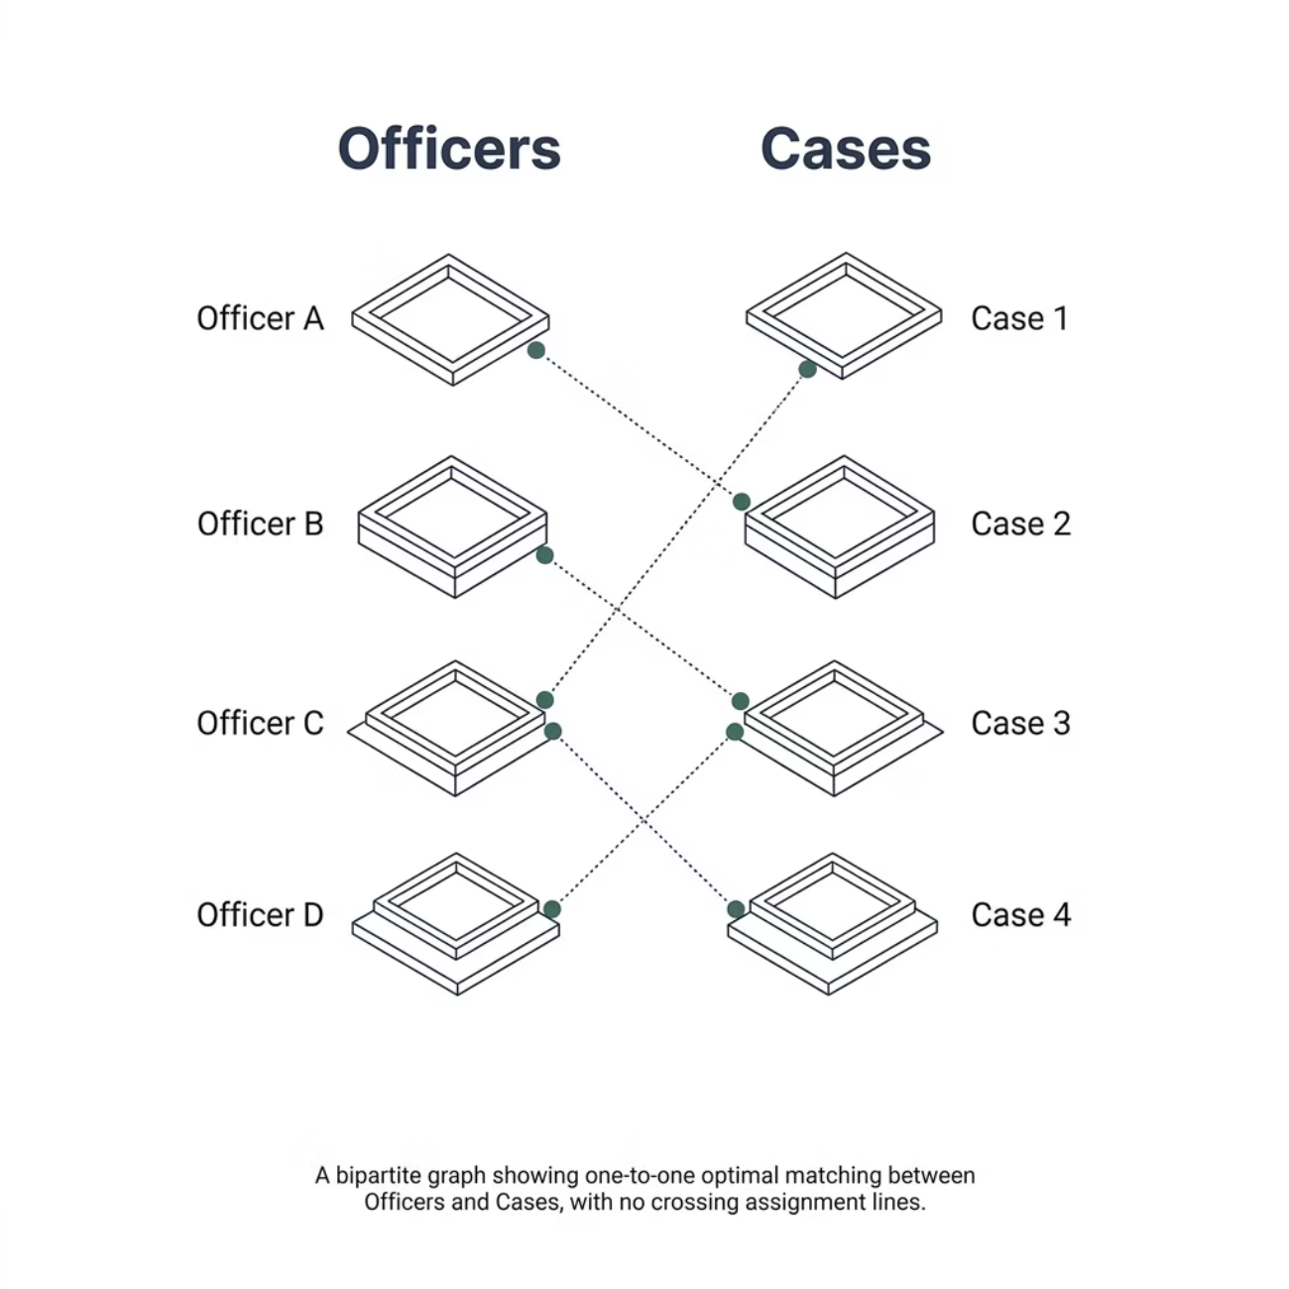

Our AI Solution: Bipartite Matching
We model the assignment problem as a bipartite graph — two distinct sets with no internal connections.
Set A: Officers
Set B: Cases
Optimal Edges
Each officer is a node carrying attributes: rank, skill profile, current workload, and location.
Each case is a node with attributes: type, complexity, location, and priority level.
The algorithm finds the optimal lines connecting officers to cases — minimising total cost across all assignments.

Slide 4
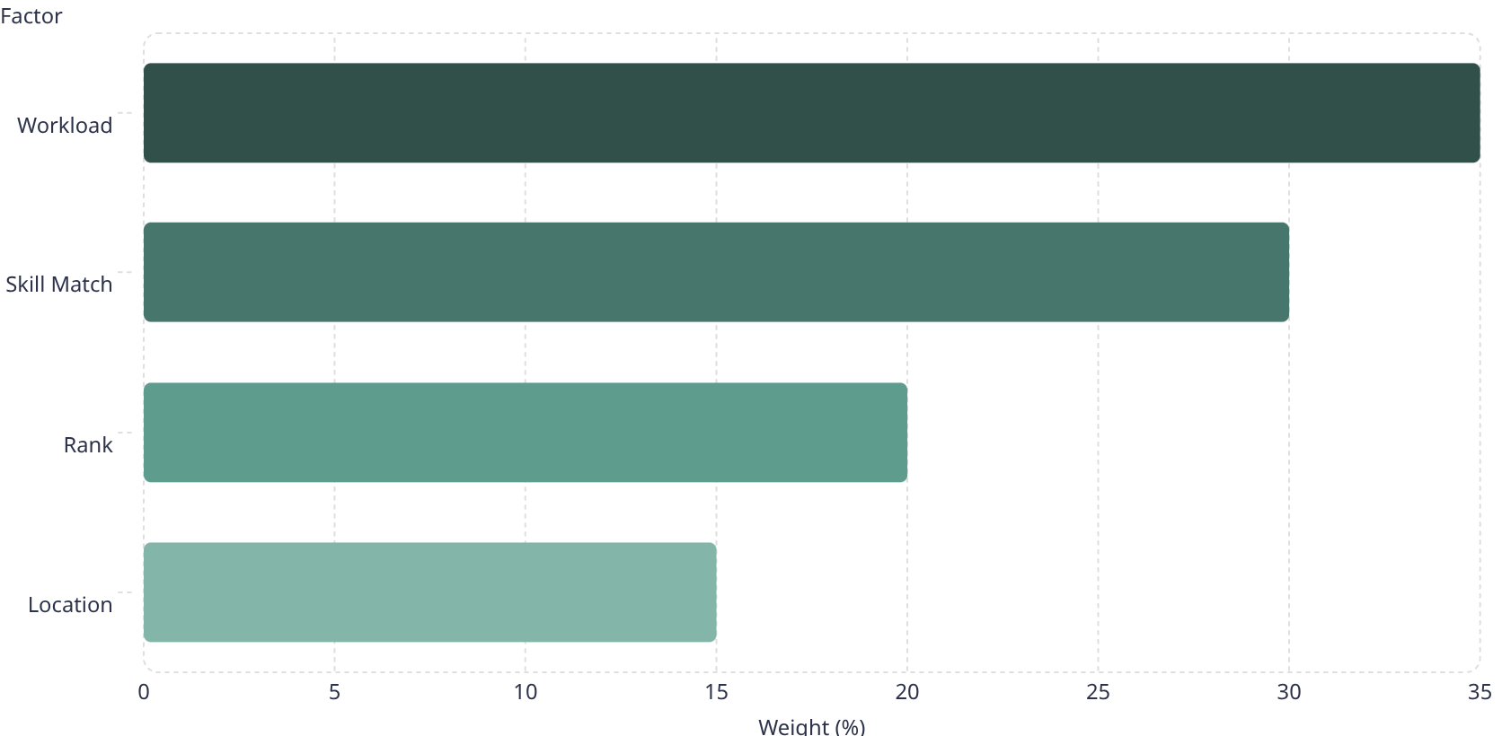
The Secret Sauce: The Cost Matrix
Every officer-case pairing is scored using a weighted cost matrix. The lower the cost, the better the fit.
1
2
35% — Workload
30% — Skill Match
Heavily penalises assigning cases to officers already carrying 8–9 cases using an exponential curve.
Matches case type to officer specialisation for higher-quality investigations.
3
4
20% — Rank
15% — Location
Ensures seniority-appropriate case distribution across the force.
Uses the Haversine Formula to calculate real-world geographic distance between officer and case.

Slide 5
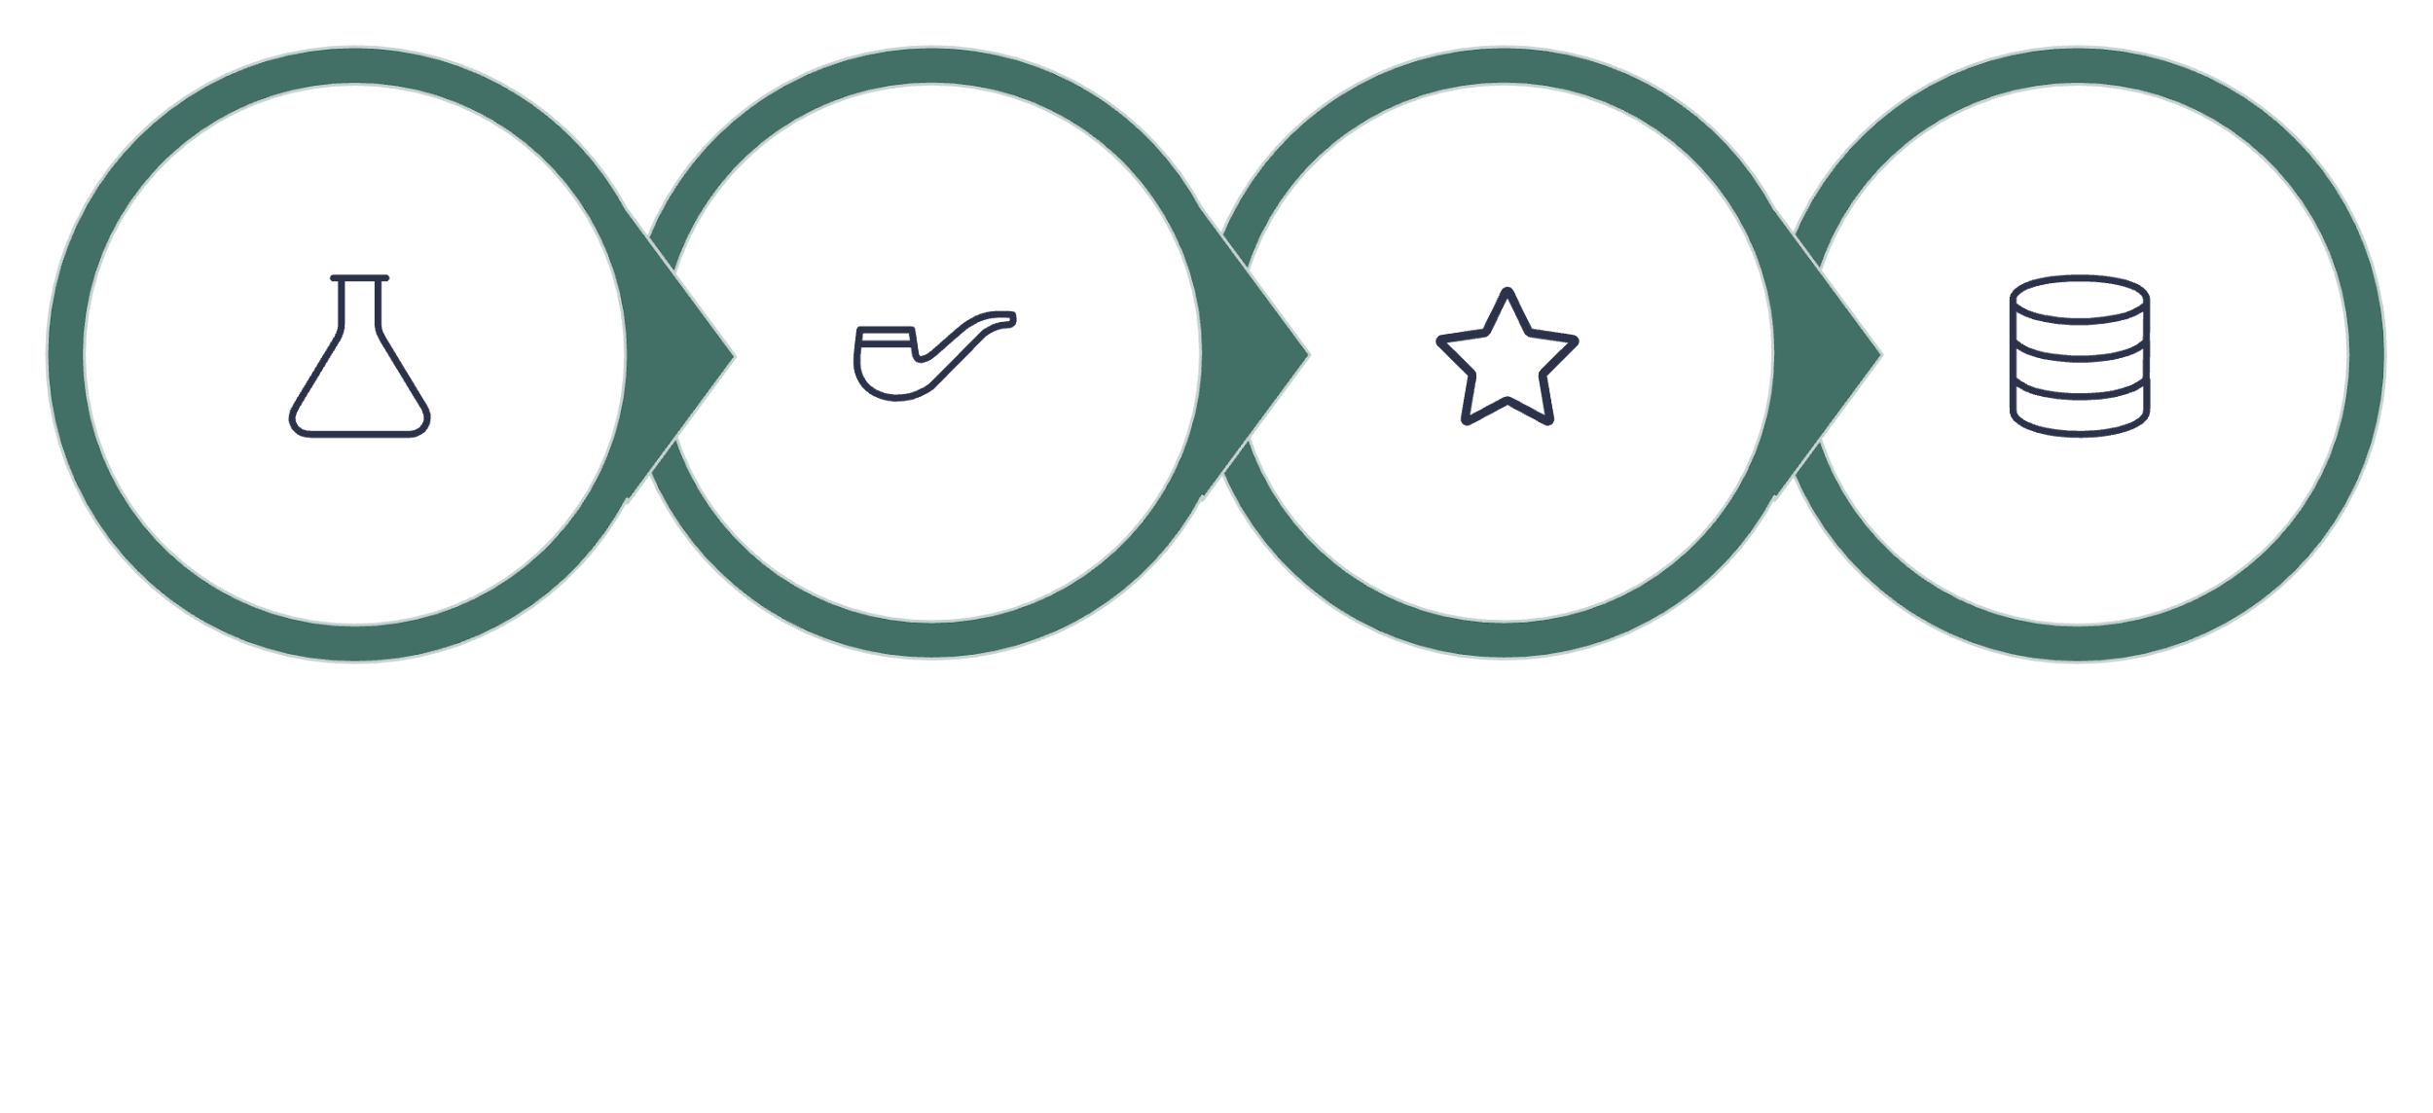




Cross-Course Integration
The Python AI doesn't run in a vacuum. It compresses its status into C-struct bytes and sends it through a POSIX Named Pipe to our C++ backend — a seamless multi-language pipeline.
Python AI
OS IPC
C++ Backend
PostgreSQL
This architecture demonstrates real-world systems engineering: Python handles the AI logic, the OS layer manages safe IPC, C++ processes the data at speed, and PostgreSQL ensures analytics-ready storage with schema isolation to prevent data corruption.

Slide 6

Conclusion
O(n³)
4
0
Time Complexity
Weighted Factors
Data Corruption Risk
Guaranteed optimal assignment in polynomial time — scalable and predictable for real-world deployment.
Workload, Skill, Rank, and Location combined into a single intelligent cost matrix.
DB schema isolation and strict IPC protocols prevent cross-process data corruption entirely.
JusticeFlow AI replaces guesswork with mathematical optimisation — ensuring every officer gets the right case, at the right time, with the right capacity.
Thank You!
Abdullah Muaz Abbasi · Muhammad Furqan · Muhammad Abu Bakar

